Slide 1
Managerial Accounting
Lecture 07: Incremental Analysis
Chapter
27
Masud Jahan
Department of Science and Humanities
Military Institute of Science and Technology

Slide 2

Learning Objective
To explain what
makes information
relevant to a
particular business
decision
LO1
<number>/47
Notes:
Learning objective number 1 is to explain what makes information relevant to a particular business decision.

Slide 3
The Challenge of Changing Markets
Product markets can change quickly due to competitor
price cuts, changing customer preferences, and
introduction of new products by competitors.
Managers must make short-run decisions, with a fixed set
of resources, to react to the changing market place.
Special
order
decisions
Product
mix
decisions
Make
or buy
decisions
Joint
product
decisions
<number>/47
Notes:
A rapidly changing market place, with both opportunities and challenges, often requires management to make short-run decisions that can have significant impacts on profits. In the short-run, resources are usually fixed, so in most cases, managers must make these decisions without the possibility of acquiring additional capacity, operating time, or materials. Examples of these decisions often faced by management are displayed on the lower portion of your screen.

Slide 4


Incremental Analysis
Occurs when there is more than one alternative choice of action.
Alternative One
Alternative Two
<number>/47

Slide 5
Learning Objective
To discuss the
relevant information
in business decisions
LO2
<number>/47
Notes:
Learning objective number 1 is to explain what makes information relevant to a particular business decision.

Slide 6
Relevant Information in Business Decisions
Cost & revenue that varies among the
possible alternative courses of action being considered
<number>/47
Notes:
Relevant information differs between the alternatives under consideration. Before we look at the decisions mangers make using incremental analysis, we will consider opportunity costs, sunk costs, and out-of-pocket costs.

Slide 7
Decision Making
Decision making involves five steps:
  Define the problem.
  Identify the alternatives.
  Collect information on alternatives.
  Eliminate irrelevant information.
  Make a decision with the
  remaining relevant information.
<number>/47
Notes:
These five steps represent an orderly, structured decision-making process that will lead to better decisions. First we need to clearly define the problem and consider all feasible alternatives. Next we need to gather information. Some of the information might not be relevant, so we need to discard that information and concentrate on using only relevant information to select the best alternative.

Slide 8

Relevant Cost
A relevant cost is a future cost that differs between alternatives.
<number>/47

Slide 9

Opportunity Cost
Opportunity cost is the potential benefit that is given up when one alternative is selected over another.
<number>/47

Slide 10
Opportunity Cost
Example: If you do not join M.Sc. program, you could be earning TK120,000 per year.
Your opportunity cost of joining M.Sc. program for one year includes the TK120,000.
Opportunity costs are not recorded in the accounting records, but are relevant to decisions because they are a real sacrifice.
<number>/47
Notes:
Opportunity costs are the potential benefits that are given up when one alternative is selected over another. Opportunity costs are not actual dollar outlays; however, they may impact our decisions. For example, some of you may have made the decision to attend college rather than go straight into the work force. The opportunity cost of attending college is the lost salary that you could have earned, had you worked.

Slide 11

Sunk Cost
A sunk cost is a cost that has already been incurred and that cannot be changed by any decision made now or in future.
Sunk costs should not be considered in decisions.
  Example: You bought an automobile that cost
  Tk 600,000 two years ago. The Tk 600,000 cost is sunk because whether you drive it, park it, trade it, or sell it, you cannot change the Tk 600,000 cost.
<number>/47
Notes:
Sunk costs cannot be changed by any decision we make as they have been incurred in the past and cannot possibly differ between any alternative that we might currently choose. Dwelling on sunk costs can frequently be the cause of decision errors. Sunk costs should not be considered in the decision process. For example, if you bought an automobile two years ago for $10,000, that amount is a sunk cost. Whether you drive the car, park it, trade it, or sell it, the $10,000 cost will not change.

Slide 12

Out-of-Pocket Costs
An out-of-pocket cost is a cost requiring cash disbursements in the current accounting period.
Out-of-Pocket costs should be considered in decisions.
  Example: You wish to buy an new automobile that cost
  Tk 1,000,000 today. The Tk 1,000,000 cost is Out-of-Pocket cost because it requires a actual cash outlay in the current accounting period to materialize the acquisition.
<number>/47
Notes:
Sunk costs cannot be changed by any decision we make as they have been incurred in the past and cannot possibly differ between any alternative that we might currently choose. Dwelling on sunk costs can frequently be the cause of decision errors. Sunk costs should not be considered in the decision process. For example, if you bought an automobile two years ago for $10,000, that amount is a sunk cost. Whether you drive the car, park it, trade it, or sell it, the $10,000 cost will not change.

Slide 13
Learning Objective
To use incremental analysis
in common business
decisions.
LO3
<number>/47
Notes:
Learning objective number 3 is to use incremental analysis in common business decisions.

Slide 14

Types of Incremental Analysis
Accept an order at a special price
Make or buy components or finished products
Sell products or process further
Retain or replace equipment
Eliminate an unprofitable business segment
Allocate limited resources
<number>/47
Notes:
1. On the topic, “Challenges Facing Financial Accounting,” what did the AICPA Special Committee on Financial Reporting suggest should be included in future financial statements?
Non-financial Measurements (customer satisfaction indexes, backlog information, and reject rates on goods purchases).
Forward-looking Information
Soft Assets (a company’s know-how, market dominance, marketing setup, well-trained employees, and brand image).
Timeliness (no real time financial information)

Slide 15

Special Order Decisions
The decision to accept additional business should be based on incremental costs and incremental revenues.
Incremental amounts are those that occur only if the company decides to accept the new business.
<number>/47
Notes:
On occasion, we may have the opportunity to accept additional business through a special order. We should make the decision to accept or reject the additional business using incremental revenues and incremental costs. Some of our costs may not change if we accept additional business. Those costs are not relevant as they do not differ between the alternative accept or reject the additional business.

Slide 16
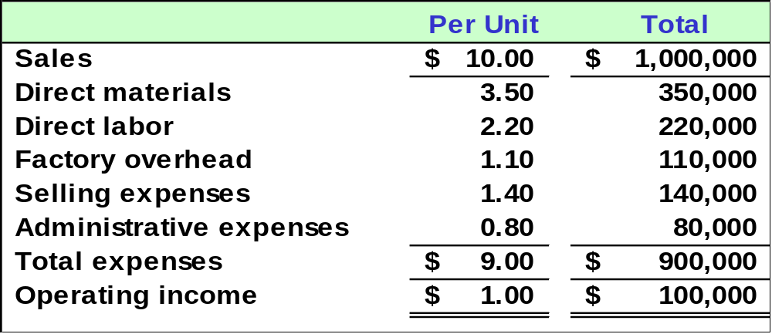
Special Order Decisions
View Co. currently sells 100,000 units of its product. The company has revenue and costs as shown below:
<number>/47
Notes:
View Company makes 100,000 units of a single product that normally sells for ten dollars per unit. Total cost to make one unit is nine dollars, resulting in a one dollar profit per unit.

Slide 17
Special Order Decisions
View Co. is approached by an overseas
company that offers to purchase
10,000 units at $8.50 per unit.
If View Co. accepts the offer, total factory
overhead will increase by $5,000; total selling expenses will increase by $2,000; and total administrative expenses will increase
by $1,000.
Should View Co.
accept the offer?
<number>/47
Notes:
A foreign distributor offers to purchase 10,000 units at $8.50 each. View Company will have some additional costs if the order is accepted: Total factory overhead will increase by $5,000; total selling expenses will increase by $2,000; and total administrative expenses will increase by $1,000.
We will assume that View Company has enough idle capacity to make the 10,000 units and that this is a one-time order which will not affect the company’s regular business.
Should View Company accept this special order from the foreign distributor?

Slide 18

Special Order Decisions
First let’s look at incorrect reasoning
that leads to an incorrect decision.
Our cost is $9.00
per unit. I can’t sell
for $8.50 per unit.
<number>/47
Notes:
First let’s look at an incorrect approach to the decision that does not consider incremental revenues and incremental costs. If we compare the foreign distributor’s offer with View Company’s unit cost, we see that the offer is fifty cents less than the unit cost. This comparison would lead us to reject the offer.

Slide 19
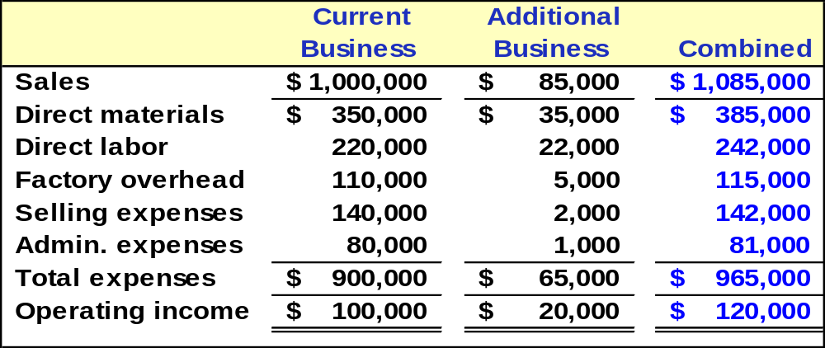
Special Order Decisions
This analysis leads to the correct decision.
<number>/47
Notes:
We can see from this correct analysis that the additional business at $8.50 per unit will increase income by $20,000. Let’s look at the reasons why this is the case.

Slide 20
Special Order Decisions
10,000 new units × $8.50 selling price = $85,000
<number>/47
Notes:
If we decide to accept this one time special order, revenue will increase by $85,000 (10,000 units at $8.50 per unit)..

Slide 21
Special Order Decisions
10,000 new units × $3.50 = $35,000
<number>/47
Notes:
Direct material is a variable cost that will increase in direct proportion to the increase in sales.

Slide 22
Special Order Decisions
10,000 new units × $2.20 = $22,000
<number>/47
Notes:
Direct labor is also a variable cost that will increase in direct proportion to the increase in sales. Factory overhead, selling expenses and administrative expenses are largely fixed costs that increase but not in direct proportion to sales as do the variable costs.

Slide 23
Special Order Decisions
Even though the $8.50 selling price is less than the
normal $10 selling price, View Co. should accept the
offer because net income will increase by $20,000.
<number>/47
Notes:
By comparing comparing incremental revenue of $85,000 with the total incremental costs of $65,000, we see why the income from additional business is $20,000. Now we can make the correct decision to accept the additional business.

Slide 24

Make or Buy Decisions
Should I
continue to make
the part, or should
I buy it?
I suppose I
should compare
the outside purchase
price with the additional
costs to manufacture
the part.
What will I
do with my
idle facilities if
I buy the part?
<number>/47
Notes:
The “Make or Buy” decision involves the question of whether it is more economical to produce some goods internally or purchase them from an outside supplier.

Slide 25

Make or Buy Decisions
Incremental costs also are important in the decision to make a product or buy it from a supplier.
The cost to produce an item must include
(1) direct materials, (2) direct labor and
(3) incremental overhead.
<number>/47
Notes:
We will again concentrate on incremental costs for this decision. The direct labor and direct material costs to make a product are incremental costs. Some part of overhead might be incremental, but most of the overhead will probably remain unchanged with the make or buy decision.

Slide 26
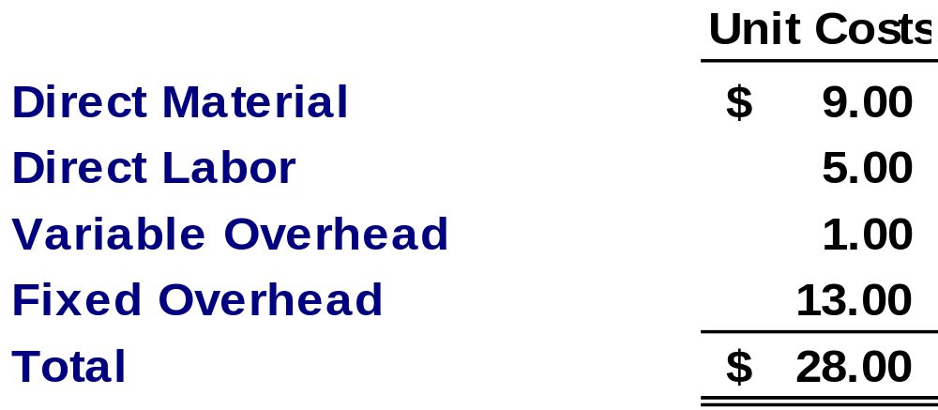
Make or Buy Decisions
Excel makes computer chips used in
one of its products. Unit costs, based on production of 20,000 chips per year, are:
<number>/47
Notes:
In our example, Excel Company produces computer chips used in one of its products. Unit costs based on an annual volume of 20,000 chips are shown on your screen.

Slide 27
Make or Buy Decisions
An outside supplier has offered to provide the 20,000 chips at a cost of $25 per chip. Fixed overhead costs will not be avoided if the chips are purchased. Excel has no alternative use for the facilities.
Should Excel accept the offer?
<number>/47
Notes:
An outside supplier approaches Excel and offers to sell us 20,000 chips for twenty-five dollars per chip. The fixed overhead costs will be unaffected by whatever decision we make. If we buy the chips, the current production facility will remain idle. Should we accept accept this offer?

Slide 28
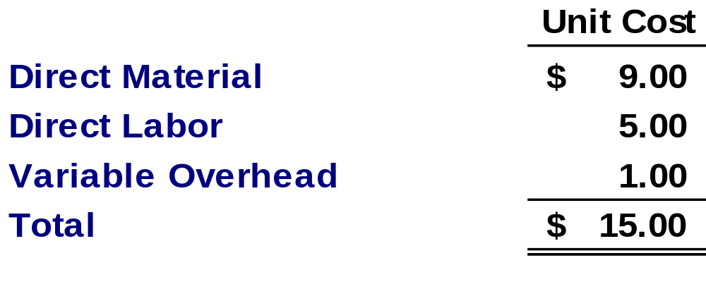
Make or Buy Decisions
Differential costs of making (costs avoided if bought from outside supplier)
Excel should not pay $25 per unit to an outside supplier to avoid the $15 per unit differential cost of making the part. Fixed costs are irrelevant to decision.
<number>/47
Notes:
Part I
If we purchase from the outside supplier, we will avoid fifteen dollars dollars per unit in production costs. We will no longer buy material for a savings of nine dollars per unit; we will not need labor time for a savings of five dollars per unit; and we will save one dollar per unit in variable overhead support. Fixed overhead is the same for both alternatives, so it is irrelevant to the decision.
Part II
We should not pay the outside supplier twenty five dollars per unit to avoid the fifteen dollars incremental cost per unit to make the chips.

Slide 29


Make or Buy Decisions
If Excel buys the chips from the outside supplier, the idle facilities could be leased to another company for $250,000 per year.
Should Excel buy the chips and
lease the facilities?
<number>/47
Notes:
We have now found an alternative use for the facilities used to make the chips. If we buy the chips from the outside supplier, we can lease the idle facilities to another company for $250,000 per year.
Will this new information change our decision?

Slide 30
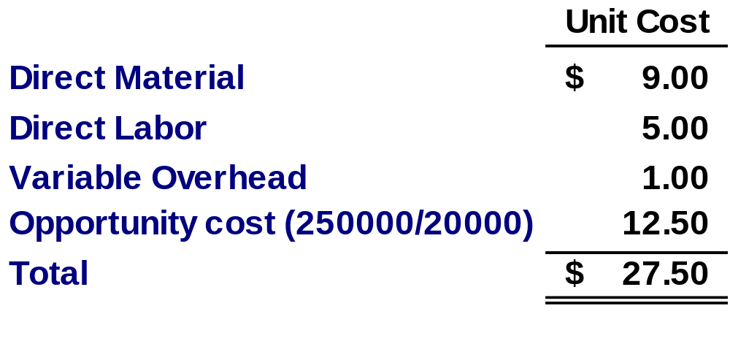
Make or Buy Decisions
Differential costs of making (considering opportunity cost of facilities )
The opportunity cost of facilities changes the decision.
<number>/47
Notes:
Part I
If we purchase from the outside supplier, we will avoid fifteen dollars dollars per unit in production costs. We will no longer buy material for a savings of nine dollars per unit; we will not need labor time for a savings of five dollars per unit; and we will save one dollar per unit in variable overhead support. Fixed overhead is the same for both alternatives, so it is irrelevant to the decision.
Part II
We should not pay the outside supplier twenty five dollars per unit to avoid the fifteen dollars incremental cost per unit to make the chips.

Slide 31
Sell, Scrap, or Rebuild Decisions
Costs incurred in manufacturing units of product that do not meet quality standards are sunk costs and cannot be recovered.
As long as rebuild costs are recovered through sale of the product, and rebuilding does not interfere with normal production, we should rebuild.
<number>/47
Notes:
Often in production processes, we have product that does not pass inspection. We can either sell it as is, or rebuild it to improve the quality. Once rebuilt, the product will likely be sold for a higher price. The decision to rebuild or sell as is should be based on incremental revenues and incremental costs. The costs of manufacturing the product up to the inspection point are sunk and therefore irrelevant

Slide 32
Sell, Scrap, or Rebuild Decisions
Servo has 10,000 defective units that cost $1.00 each to make. The units can be scrapped now for $.40 each or rebuilt at an additional cost of $.80 per unit.
If rebuilt, the units can be sold for the normal selling price of $1.50 each. Rebuilding the 10,000 defective units will prevent the production of 10,000 new units that would also sell for $1.50.
Should Servo scrap or rebuild?
<number>/47
Notes:
Servo has 10,000 defective units that can be sold as is for 40 cents per unit, or rebuilt and sold for $1.50 per unit. The cost of rebuilding the defective units is 80 cents each. The one dollar per unit original cost to make the defective units is a sunk cost and irrelevant to the decision.
Servo does not have the capacity to rebuild the defective units and continue with its normal production. Rebuilding the defective units will prevent the production of 10,000 new units that would also sell for $1.50.
What should Servo do?

Slide 33
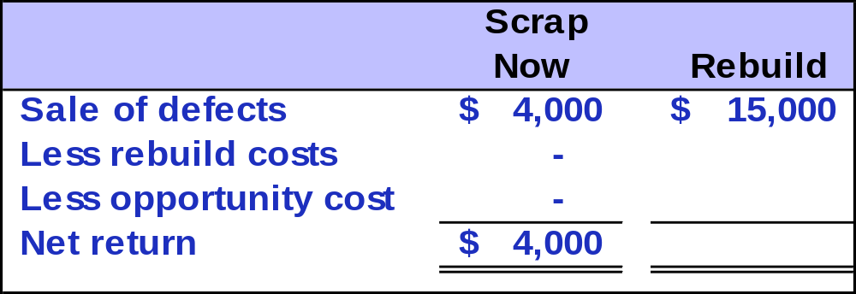
Sell, Scrap, or Rebuild Decisions
10,000 units × $0.40 per unit
10,000 units × $1.50 per unit
<number>/47
Notes:
Sale of the 10,000 defective units as is for 40 cents will generate $4,000. Rebuilding and selling each unit for $1.50 will generate $15,000.

Slide 34
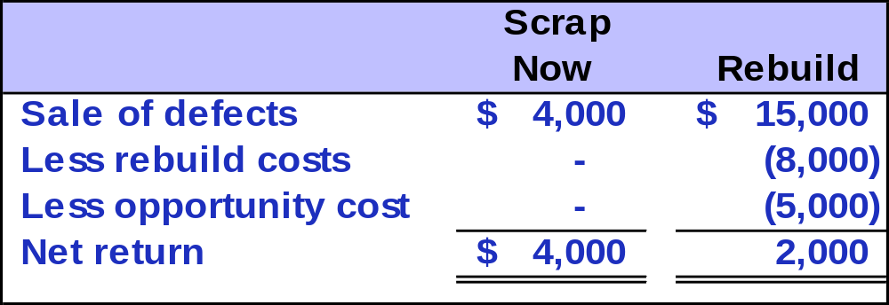
Sell, Scrap, or Rebuild Decisions
10,000 units × $0.80 per unit
10,000 units × ($1.50 - $1.00) per unit
<number>/47
Notes:
The total cost to rebuild the 10,000 defective units at 80 cents each will be $8,000. We must also include the opportunity cost of 10,000 units of regular production that would be prevented by rebuilding the defective units. The regular units sell for $1.50 each and cost $1.00 per unit to make. We give up the opportunity to earn this $5,000 if we rebuild the defective units.

Slide 35
Sell, Scrap, or Rebuild Decisions
Servo should scrap the units now.
If Servo fails to include the opportunity cost,
the rework option would show a return of $7,000,
mistakenly making rebuild appear more favorable.
<number>/47
Notes:
Servo should sell the defective units as is for $4,000 as the net return is $2,000 higher than rebuilding the defective units. Note that if Servo does not include the opportunity cost of the displaced regular production, they will make an incorrect decision to rebuild the defective product. Failing to include the opportunity cost would result in an incorrect $7,000 net return for the rebuild alternative.

Slide 36
Production Constraint Decisions
Managers often face the problem of deciding how scarce resources are going to be utilized.
Usually, fixed costs are not affected by this particular decision, so management can focus
on maximizing total contribution margin.
Let’s look at the ABC Company example.
<number>/47
Notes:
All businesses face constraints that affect production and sales decisions. They must make decisions to best utilize constrained resources. Usually fixed costs are not affected by this particular decision, so management can focus on maximizing the contribution margin given the constraints and the demand for products.
Let’s look at an example.

Slide 37
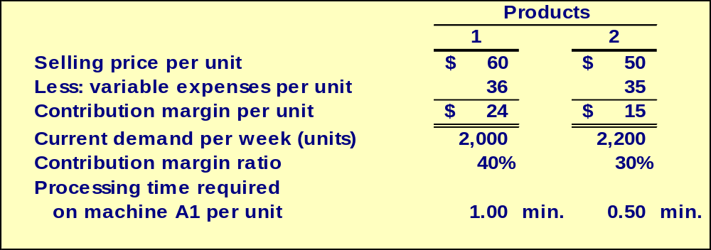

Production Constraint Decisions
ABC Company produces two products and selected data is shown below:
<number>/47
Notes:
Kaiser Company produces Product One and Product Two. Product One has a contribution margin of twenty four dollars and Product Two has a contribution margin of fifteen dollars. The demand per week is 2,000 units of Product One and 2,200 units of Product Two. The contribution margin ratio is forty percent for Product One and thirty percent for Product Two.
One of the important considerations in manufacturing is the time required to produce the products. It takes one minute to produce one unit of Product One, and it takes one half minute to produce one unit of Product Two. In other words, in the same time that it takes to produce one unit of Product One, we can produce two units of Product Two.
Additional information about the constrained resource is on the next slide.

Slide 38
Production Constraint Decisions
Machine A1 is the scarce resource because there is excess capacity on other machines. Machine A1 is being used at 100% of its capacity.
Machine A1 capacity is 2,400 minutes per week.
Should ABC focus its efforts on Product 1 or 2?
<number>/47
Notes:
In this example, Machine A1 is the constrained resource and is being used at 100 percent of capacity. Other machines still have some idle time. Machine A1 has a capacity of 2,400 minutes per week.
Which product should Kaiser emphasize?
Let’s see how we would analyze the best way to utilize the time on machine A1.

Slide 39
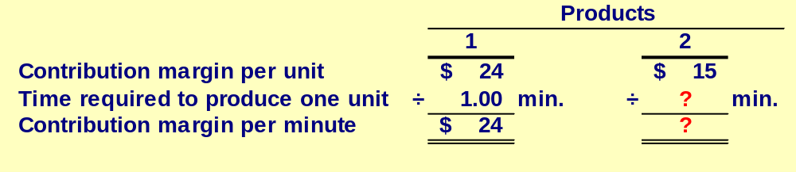
Production Constraint Decisions
Let’s calculate the contribution margin per unit of the scarce resource, machine A1.
<number>/47
Notes:
The key to understanding the utilization of constrained resources is to determine the contribution margin per unit of the constrained resource used by the various products. Time on machine A1 is the constrained resource for Kaiser.
We can see that if it takes one minute to produce one unit of Product One and Product One has a contribution margin of twenty four dollars. So, if we produce Product One we would generate a contribution margin of twenty four dollars in for each minute of time on machine A1.
How much contribution margin per minute would we have if we produced Product Two?

Slide 40
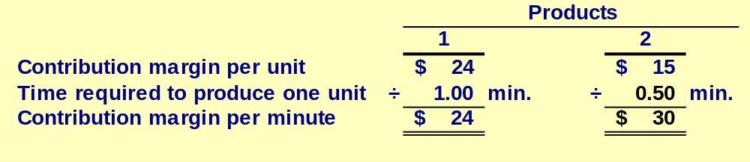
Production Constraint Decisions
Let’s calculate the contribution margin per unit of the scarce resource, machine A1.
Product 2 should be emphasized. It is the more valuable use of the scarce resource, machine A1, yielding a contribution margin of $30 per minute as opposed to $24 for Product 1.
<number>/47
Notes:
We can make two units of Product Two in one minute. At a contribution margin of fifteen dollars per unit, we could generate thirty dollars per minute in contribution margin if we make Product Two.
Product Two should be emphasized because it provides more value to the company through its higher contribution margin. Let’s see what decisions should be made regarding production.

Slide 41
Production Constraint Decisions
Let’s calculate the contribution margin per unit of the scarce resource, machine A1.
If there are no other considerations, the best plan would be to produce to meet current demand for Product 2 and then use any capacity that remains to make Product 1.
<number>/47
Notes:
The best strategy for Kaiser Company would be to produce to meet all the demand for Product Two and any remaining time on machine A1 would then be used to produce Product One.

Slide 42
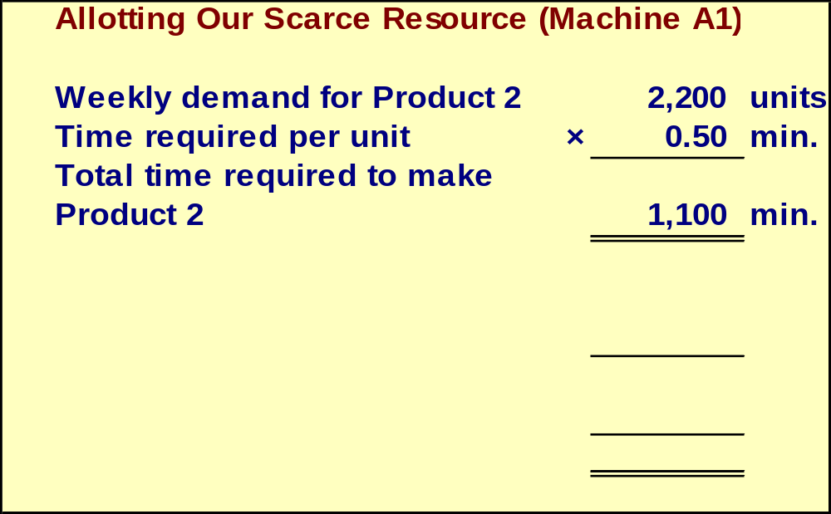
Production Constraint Decisions
Let’s see how this plan would work.
<number>/47
Notes:
The weekly demand for Product Two is 2,200 units. At half a minute per unit, it will require 1,100 minutes of machine A1 time to manufacture enough product to meet the demand for Product Two.

Slide 43
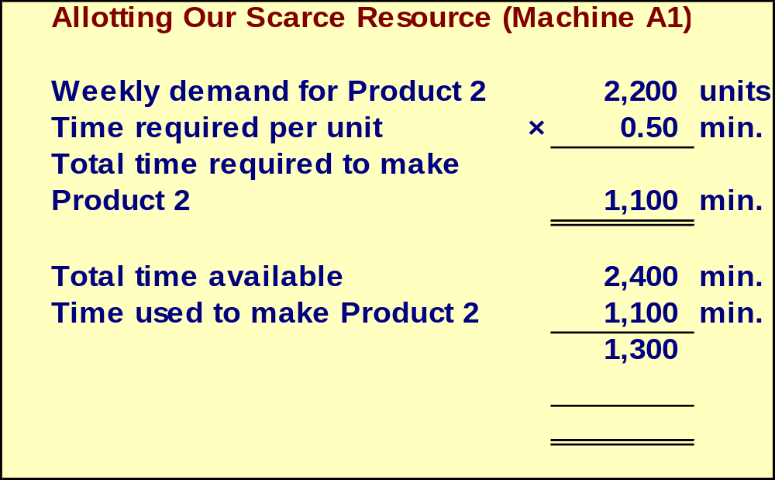
Production Constraint Decisions
Let’s see how this plan would work.
<number>/47
Notes:
Using 1,100 minutes on Product Two leaves us with 1,300 minutes available to produce Product One.

Slide 44
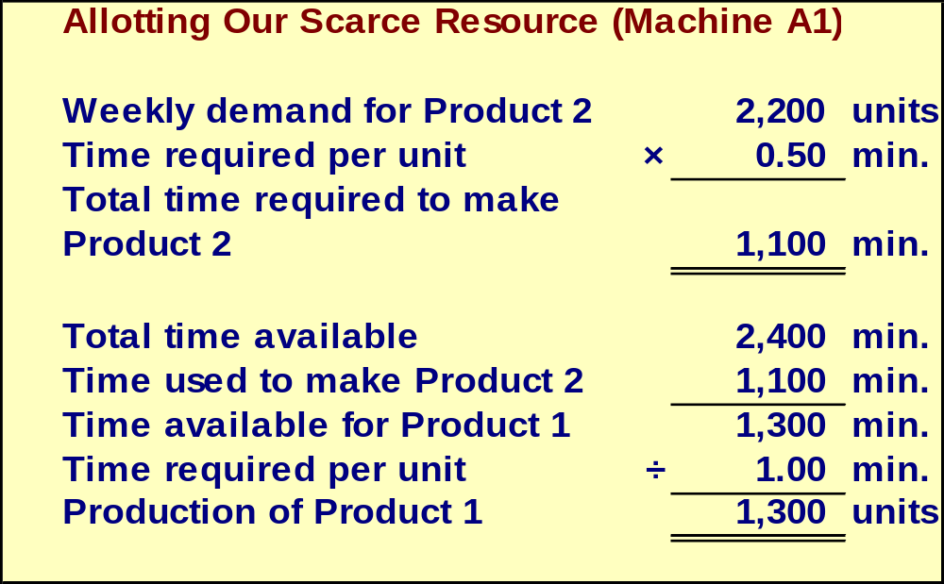
Production Constraint Decisions
Let’s see how this plan would work.
<number>/47
Notes:
Because it takes one minute to produce one unit of Product One, we will be able to produce 1,300 units of Product One. In any given week, we should produce 2,200 units of Product Two and 1,300 units of Product One. Let’s see what kind of contribution margin that would produce for the company.

Slide 45
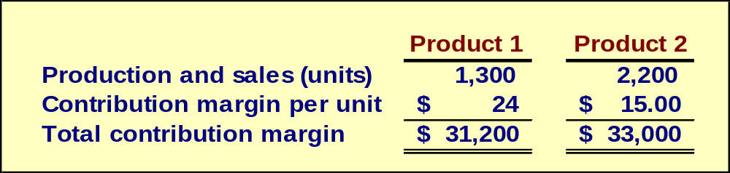
Production Constraint Decisions
According to the plan, we will produce 2,200 units of Product 2 and 1,300 of Product 1. Our contribution margin looks like this.
The total contribution margin for ABC is $64,200.
<number>/47
Notes:
Product One would produce total contribution of $31,200 and Product Two would produce total contribution of $33,000. The maximum contribution Kaiser can generate is $64,200, given the current time constraint placed upon production by machine A1. Any other combination of the two products will result in lower contribution margin.

Slide 46
End of Lecture 07
THANK YOU ALL…

